Slide 1
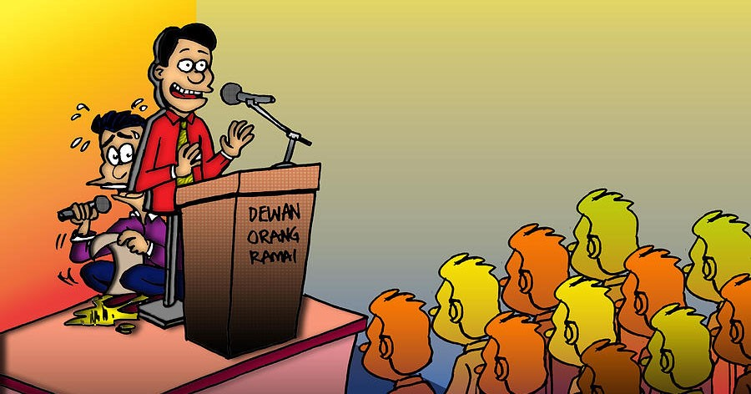
EFFECTIVE PRESENTATION STRATEGIES
By:
Rhishikesh Chaughule (14)
Vinayak Kapale (32)
Nitish Betkekar (47)
Aditi Patil (49)
Sakshi Rasal (61)
Adnan Shaikh (68)
Juveriya Tamboli (72)
Under the Guidance of
Dr. Neha Sharma
Assistant Professor
Ph.D, M.Phil, MBA
SCOE, Navi Mumbai

Slide 2
Overview
1.
Introduction
2.
Types of Effective Presentation Strategies
3.
Audience Analysis
4.
Standard Presentation Structures
5.
Characteristics of Effective Presentation
6.
Conclusion

Slide 3
INTRODUCTION
Effective presentation is an important part of modern communication.
Through effective presentation the sender would be able to convince the receiver and achieves desired result.
No matter who you are a student, an employee, a marketing manager or a CEO you have to give presentation to achieve good results.
This make us curious to know the strategies of effective presentation.

Slide 4

INTRODUCTION
Overview of important topics for Effective Presentation:
1. To make a good presentation, you need to consider the 4Ps:
Purpose
Preparation
Well-Structured Presentation
Post-Evaluation
2. Design
3. Delivery
4. Nerves
5. Audience Rapport
6. Body Language
7. Cultural Considerations

Slide 5
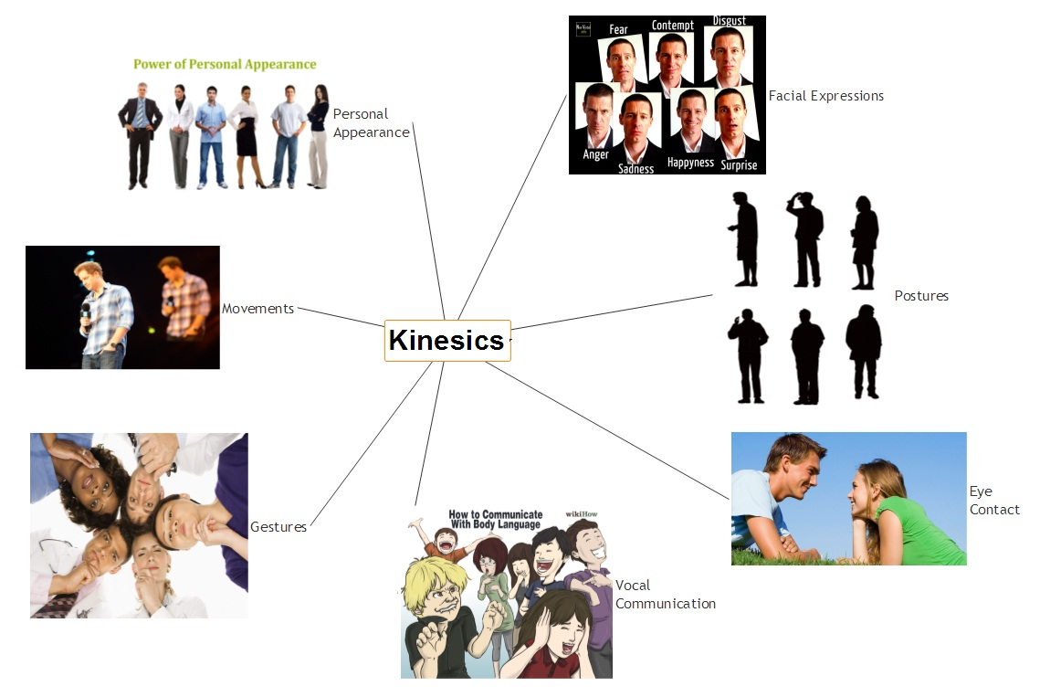
TYPES OF EFFECTIVE PRESENTATION STRATEGIES
Research
Planning
Organization
Verbal Communication
Public Speaking
Non-Verbal Communication
Kinesics
Personal Appearance
Gesture
Posture
Facial expression
Eye Contact

Slide 6

TYPES OF EFFECTIVE PRESENTATION STRATEGIES
7. Memorization
8. Writing
9. Story-Telling
10. Rhetorical Question
Ethos
Logos
Pathos
11. Active Listening
12. Adaptability
13. Delivery
14. Technical Skills
15. Analysis

Slide 7
AUDIENCE ANALYSIS
What is Audience Analysis?
Audience analysis entails identifying and understand the audience and adapting our speech to their interests, level of understanding, beliefs, and attitudes. Taking an audience-centered approach is important because if the presentation is created and delivered properly, it will improve the speaker’s effectiveness. Since identifying the audience through extensive research is challenging, audience adaptation often relies on assumptions and imagination. It’s not about telling an audience what they want to hear. Rather, it’s about the style, approach, and choice of words a speaker uses for maximum impact.

Slide 8
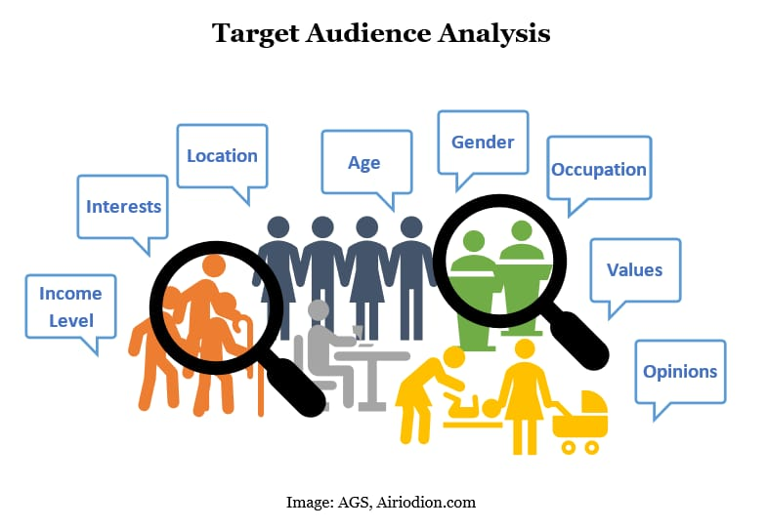
AUDIENCE ANALYSIS
Importance of Audience Analysis
Better Communication
Better Presentation
The Audience Will Understand Us Better
Types of Audience Analysis
Demographic Audience Analysis
Psychographic Audience Analysis
Situational Audience Analysis

Slide 9
STANDARD PRESENTATION STRUCTURES
The structure of a presentation is not absolutely fixed. It depends mostly upon the conventions of your research field and perhaps of the conference you are attending.
A presentation :
Has an introduction, body and conclusion
May include visual aids
Is usually followed by questions and discussions.
The introduction should orient the audience to your subject and purpose. To capture interest and set up rapport, it should tell the audience what to expect. The body of the presentation should meet the promises of purpose and information made in the introduction.

Slide 10
STANDARD PRESENTATION STRUCTURES
Your talk may involve several speakers in your group presentation. You need to manage the handover smoothly and professionally.
For example: “I would like to conclude my discussion/report at this point and hand over to my partner/colleague XYZ who will examine/discuss/report the area/topic/perspective of…”
While Concluding the topic, state your main points and what has been learned or shown but you also may raise implications inherent in the findings and offer creative recommendations.

Slide 11

CHARACTERISTICS OF EFFECTIVE PRESENTATION
1. Confidence
Excitement
Authenticity
2. Knowledge
Prepare and Practice
3. Passion
4. Self-awareness
5. Voice Modulations
6. Keep it Short and Sweet
7. Connect with your audience
8. Describe the images, but not in writing
9. Environment for speaking while presentation
10. Timing for the speech in oral presentation

Slide 12
CONCLUSION
A fantastic presentation requires preparation and a thoughtful delivery.
Consider personal appearance, body language and voice modulation.
Manage time.
Connect with your audience be confident when answering their questions and have patience.
Check the physical environment in advance.
Use visual aids.
Structure your presentation properly.
Finally, cope with stage fright by remembering that it is normal and everyone feels it.

Slide 13
THANK YOU

Slide 14
BIBLIOGRAPHY
Journals and Articles Links:
http://meiwriting.ilas.nagoya-u.ac.jp/pdf/Presentations%20book%202019-3.pdf
https://blog.markgrowth.com/
https://magneticspeaking.com/
https://slidebazaar.com/blog/audience-analysis-importance/
https://www.englishclub.com/speaking/presentations-delivery.htm
https://www.managementstudyguide.com/effective-presentation-skills.htm
https://www.nickols.us/presentations.pdf
https://www.scribd.com/document/63716155/Effective-Presentation-Strategies
https://www.ukessays.com/essays/english-language/the-characteristics-of-a-good-presentation-english-language-essay.php
https://www.zippia.com/advice/presentation-skills/

